Slide 1

Multilevel linear modelling

Slide 2
AGENDA
MLM-Definition
Explaining why we go for MLM.
What are levels in MLM?
Types of Multilevel Model

Slide 3
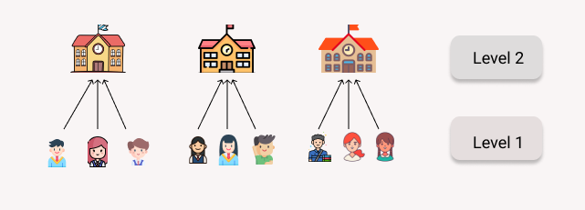

Slide 4
Multilevel Modelling
Multilevel modelling is a statistical model that is used to model the relationship between dependent data and independent data when there is a correlation between observations.

Slide 5
These models are also known as hierarchical models, mixed effect models, nested data models or random coefficient models.
The individual observations are nested inside different groups. The observations within each group are correlated.

Slide 6
Here, the schools are clusters and test scores of students are observations nested within schools.

Slide 7
When individual data is collected from a random sample of clusters (schools, areas, hospitals) at one point in time then observations within these clusters are more likely to be similar.
For example, students from different schools might perform differently in a common test while the performances of students from the same school might have some similarities.

Slide 8
With a simple regression model, there is no way we can estimate how much variation is caused at the students level and how much at the school level.
Some schools might have better study environments than some others or the faculties of one school are better than others.

Slide 9
Introducing random variables for intercepts or coefficients then estimating their variance will fetch us a better idea regarding group effects, there comes multilevel modelling.
We can use multilevel models to model the relationship between the person and their height.

Slide 10
What are levels?
The variables sampled from a larger population are eligible to be levelled.
The most fundamental observations are considered level one and subsequent groups as level 2, 3 and so on. For example,
level 3: Areas, Districts, Provinces
level 2: Schools, Hospitals, individuals
level 1: Students, Faculties, measurements

Slide 11
Types of Multilevel Model
Random Intercept Model
Random Coefficient Model

Slide 12
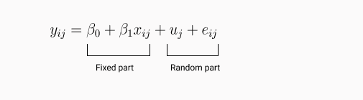
Random Intercept Model
The intercept term is allowed to vary across the clusters. We will introduce a random variable for the intercept term.
y_{ij} = β_{0j} + β₁x_{ij} + e_{ij}
where β_{0j} = β₀ + u_{j}
Here, i = individual observations j = individual clusters
combining both the equation,

Slide 13
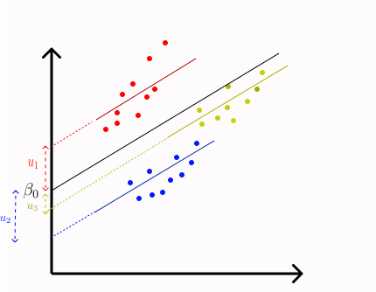
In a simple regression model, we have beta₀ as intercept. In random intercept model, the average intercept is beta₀ while for the red group it is bata₀+u₁. u_{j} is the difference between the intercept beta₀ and individual groups

Slide 14
Random Coefficient Model
We allow the slope to vary across the groups.
In some cases, random intercept alone may not be sufficient to explain variability across the groups.
So, a random slope model is needed where each group will have different slopes along with different intercepts.
In some cases, It was observed that explanatory variables might have different effects for each group.

Slide 15
In our school example if admission cutoff is an explanatory variable for test outcome then there might be schools where student scores were highly affected by the previous admission cutoff scores, there might also be some schools, the effect might be less.
Here, we can not use the same slope for every group instead each group will have its slope.

Slide 16
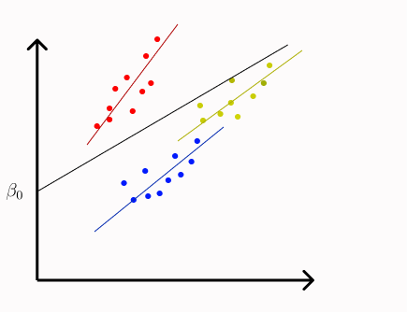
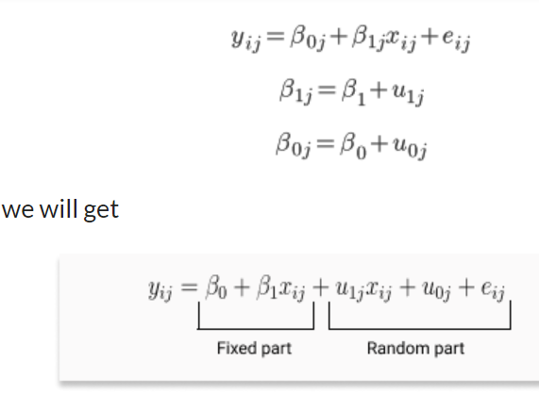
The equation for a random slope/coefficient model is given as

Slide 17
Advantages of Multilevel Modelling
Better inferences: It provides better inference from grouped data. A regular regression model does not consider the grouping of data which subsequently leads to underestimation of coefficients and overstatement of coefficient significance.
Fewer parameters: With a regular regression model we need dummy variables to account for groups but with a multilevel regression we will need fewer parameters for the same.
Group effects: Often we are specifically interested in group effects such as the role of schools in determining test outcomes of students. This can not be attained by regular regressions so we use multilevel models.

Slide 18
End-Note
Multilevel modelling is often used in research-related datasets where a regular regression is not sufficient at explaining variances across groups.

